Slide 1
NON INVASIVE POSITIVE PRESSURE
VENTILATION
DR.REZA ALIZADEH KASHANI, MD , FCCM

Slide 2
Types of mechanical ventilation
Invasive mechanical ventilation (IMV)
Non-invasive mechanical ventilation (NIV)
High low nasal cannula ventilation (NIV-HFNC)

Slide 3
NON INVASIVE MECHANICAL VENTILATION

Slide 4
HISTORY
From 1990 to the present, the use of NIV by IPPV progressively increased in acute care.
This technique is used in up to 30–40 percent of patients in critical care units.

Slide 5
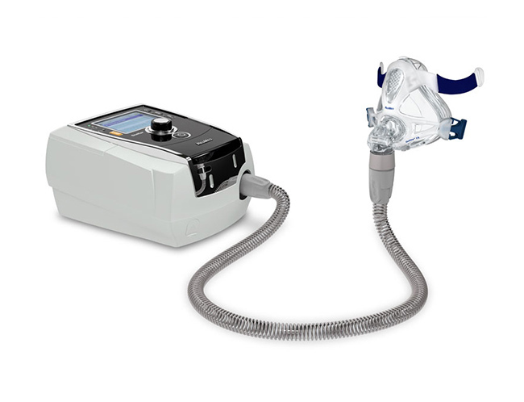

Slide 6
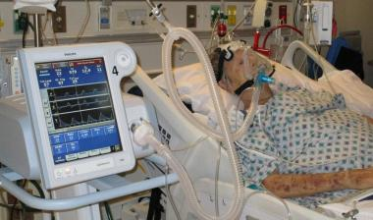

Slide 7

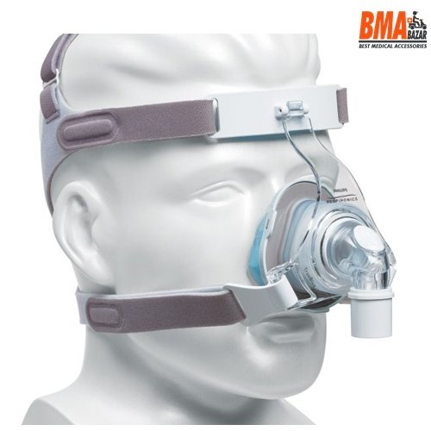
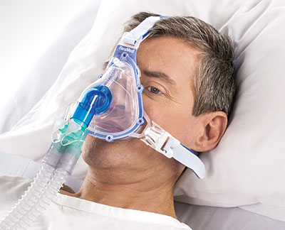
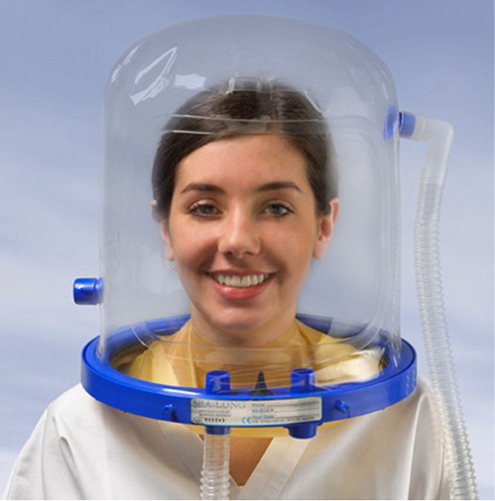

Slide 8
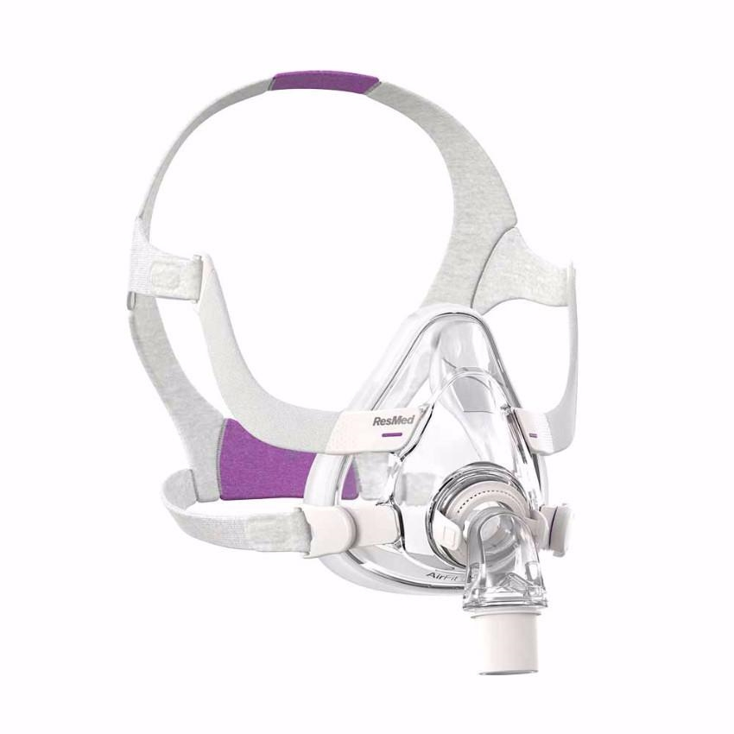

Slide 9
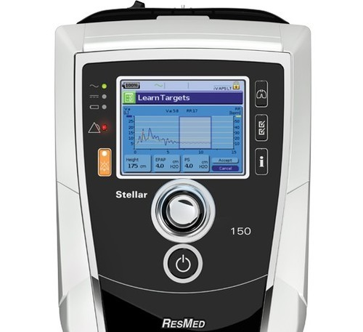
RESMED

Slide 10
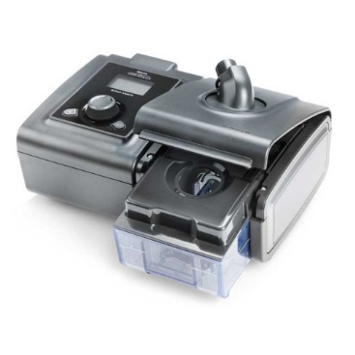
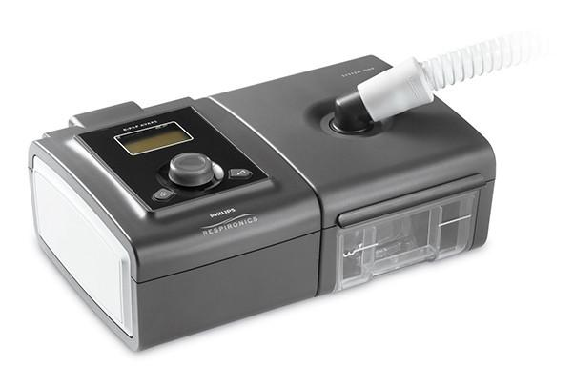
PHILIPS

Slide 11
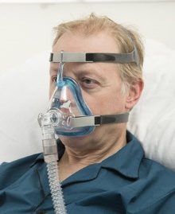
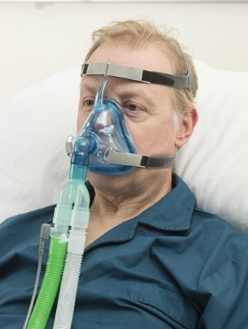

Slide 13
NIV MODES

Slide 14
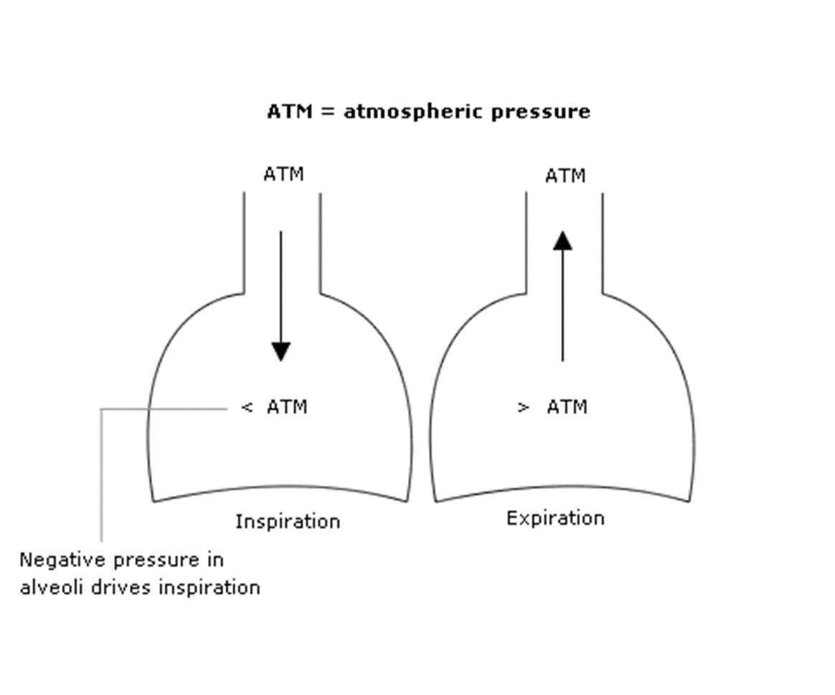
SPONTANEUS NEGATIVE PRESSURE VENTILATION

Slide 15
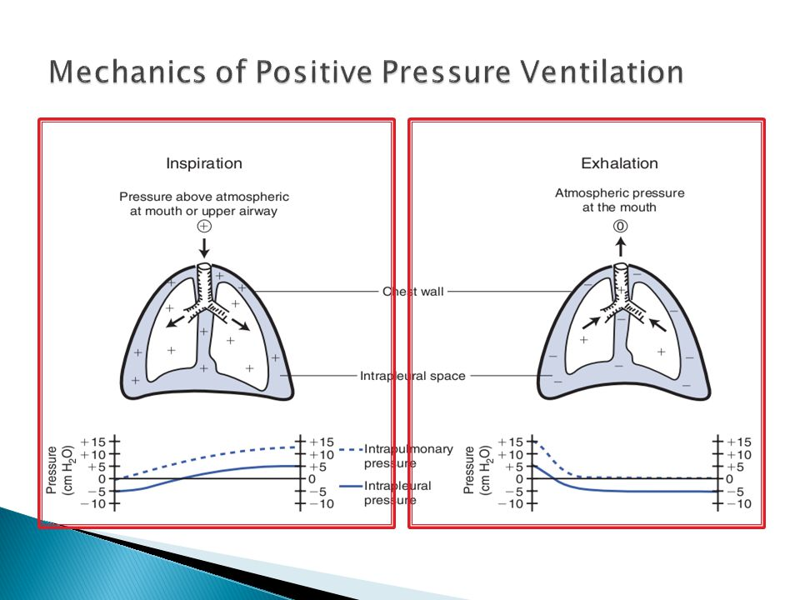

Slide 16
PRESSURE = FLOW × RESISTANCE + VOLUME / COMPLIANCE

Slide 17
IPAP – EPAP = PRESSURE SUPPORT

Slide 18
EPAP = 5 CMH2O
PSV = 10 CMH2O
IPAP = 15 CMH2O
EPAP = PEEP
PSV = PRESSURE SUPPORT
IPAP = PIP
EPAP = 10 CMH2O
IPAP = 25 CMH2O
PSV = 15 CMH2O

Slide 20
Continuous positive airway pressure
no additional pressure is applied during inhalation.
With NIV, pressure applied to the airway during the inspiratory phase is greater than the pressure applied during exhalation
provides respiratory muscle assistance,
increased tidal volume
the most common use of CPAP mode is for the treatment of obstructive sleep apnea.

Slide 21
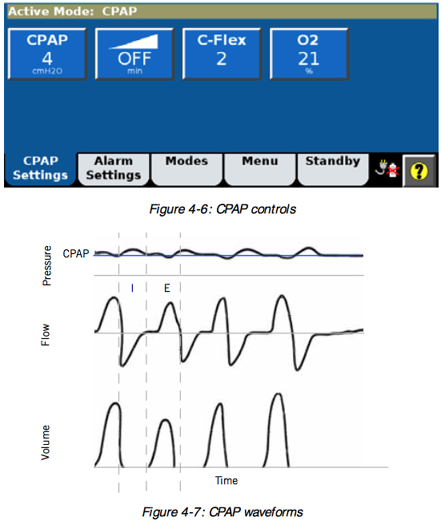

Slide 22
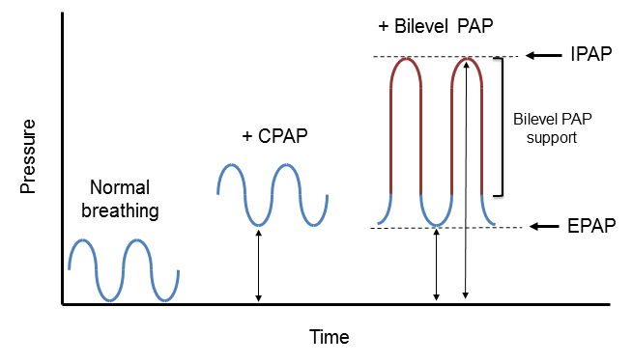

Slide 23
CPAP SETTING
CPAP = 5 CMH2O
FIO2 = 50 %

Slide 24
Pressure support ventilation
(S MODE)
Pressure support ventilation is used most commonly for NIV
IPAP and EPAP are set,
but there is no backup rate.

Slide 25
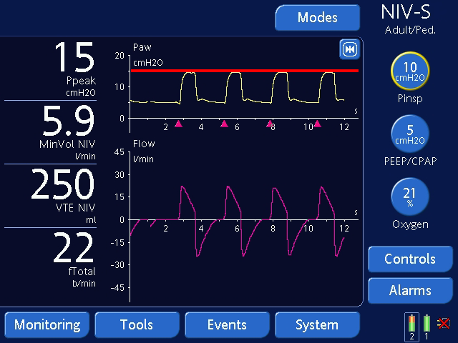

Slide 26
S MODE SETTING
EPAP = 5 CMH2O
PSV = 10 CMH2O OR IPAP = 15 CMH2O
FIO2 = 50 %

Slide 27
spontaneous/timed (S/T) mode
if the patient becomes apnoeic, the ventilator will deliver breaths at the rate set on the ventilator.

Slide 28
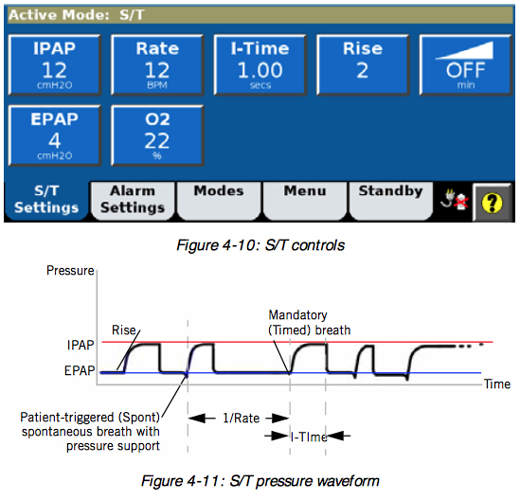

Slide 29
S/T MODE SETTING
EPAP = 5
IPAP = 15
RR = 12
FIO2 = 50
TRIGGER = 2
I – TIME = 1 S

Slide 30
Pressure-controlled ventilation
Pressure-controlled ventilation is similar to pressure support in that the ventilator applies a fixed level of pressure with each breath.
Two differences:
there is a backup rate with pressure control ( RR )
the inspiratory time is fixed ( I-TIME )
the fixed inspiratory time of pressure control is beneficial when the inspiratory phase is prolonged during pressure support due to leak

Slide 31
average volume assured pressure support (AVAPS)
AVAPS maintains a tidal volume equal to or greater than the target tidal volume , by controlling the pressure support between the minimum and maximum IPAP settings.
If patient effort decreases, AVAPS automatically increases IPAP to maintain the target tidal volume.
If patient effort increases, AVAPS will reduce IPAP

Slide 32
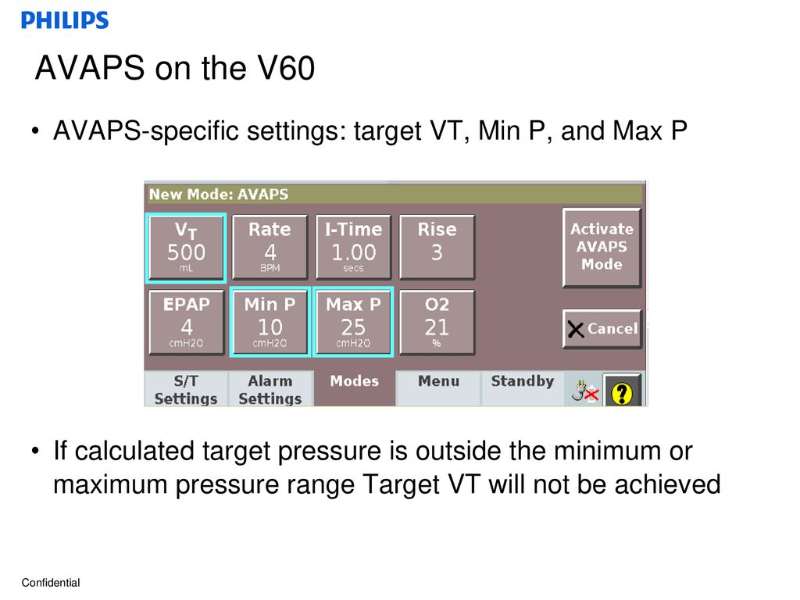

Slide 33
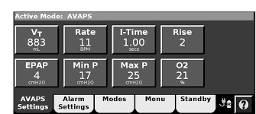

Slide 34
AVAPS MODE SETTING
EPAP = 5
MAX IPAP = 30
MIN IPAP = 15
TV = 500
RR = 12
FIO2 = 50
I-TIME = 1
TRIGGER = 2

Slide 35
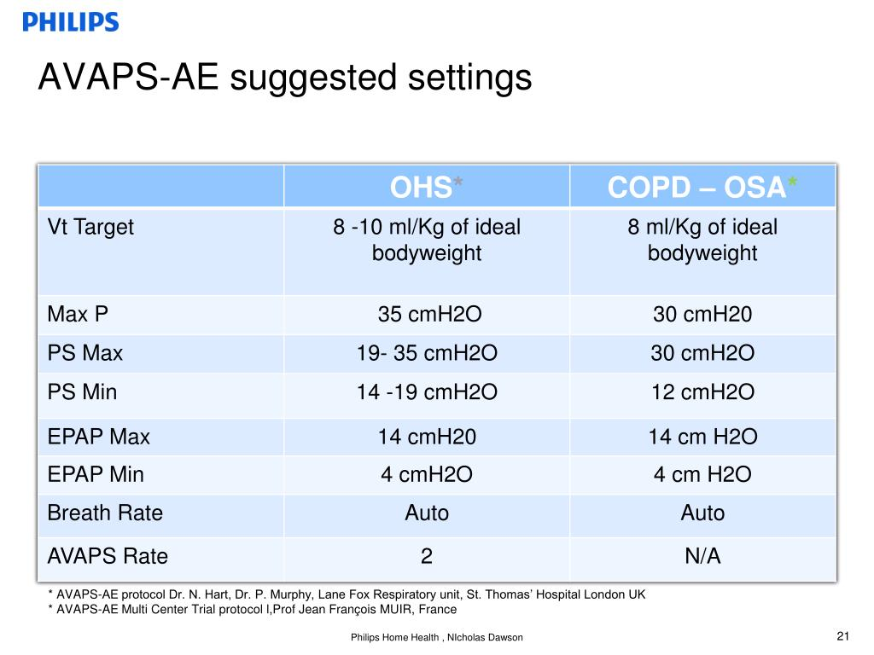

Slide 36
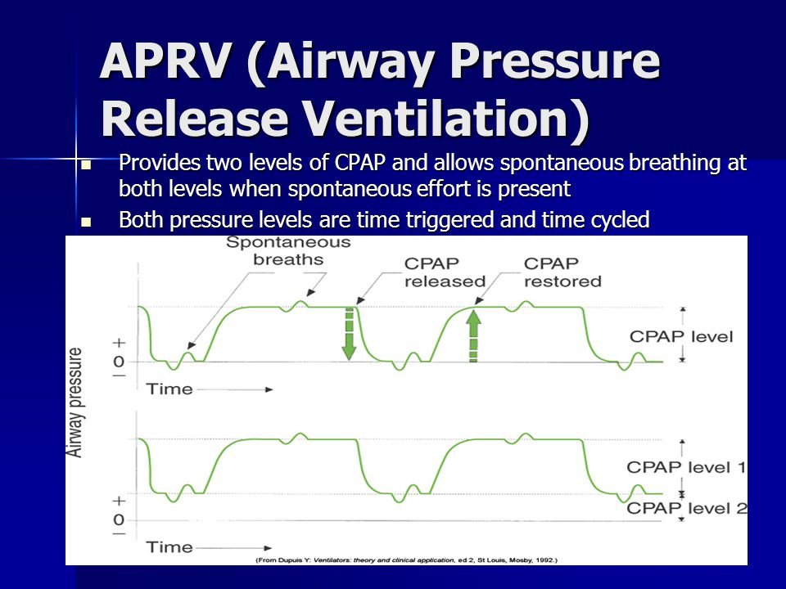
APRV (Airway Pressure Release Ventilation )

Slide 37
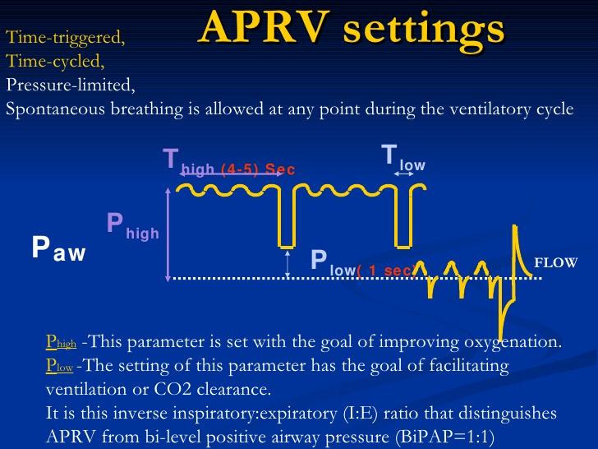

Slide 38
APRV SETTING
P high is usually set at a level between 20 and 30 cm H₂O.
P low is set between 0 and 5 cm H₂O initially.
T high: 4–6 s
T low: 0.2-0.8 seconds

Slide 39
Proportional assist ventilation
the applied pressure is determined by respiratory drive (inspiratory flow and tidal volume) and lung mechanics ( resistance and compliance),
the proportion of assist is set by the user.
improve patient tolerance during acute respiratory failure.

Slide 40
The support given is a proportion of the patient's effort and is normally set at 70 - 80%.
This support is always changing according to patient's effort and lung dynamics.
If the patient's effort and/or demand are increased, the ventilator support is increased

Slide 41
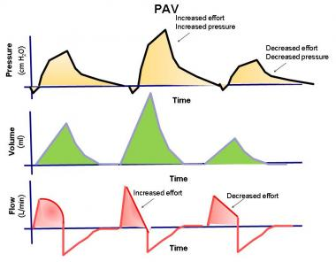

Slide 42
Neurally adjusted ventilatory assistance
(NAVA)
ventilator is triggered by electrical activity of a diaphragm
good synchrony

Slide 43
Volume-controlled ventilation
fixed tidal volume and inspiratory flow
More complicated to use
Wide range of alarms
Breath-stacking possible

Slide 44
Rise time
Rise time is the time required to reach inspiratory pressure at the onset of the inspiratory phase with pressure support .

Slide 45
How to start a patient on non-invasive ventilation

Slide 46
Education
Plan an adequate training of all staff

Slide 47
Environment
Choose the setting where to start NIV according to the severity of ARF

Slide 48
Indication
Select patients

Slide 49
Recommendations for PATIENT SELECTION
Strong positive evidence
Exacerbation of COPD
Acute cardiogenic pulmonary edema
Acute respiratory failure in immunocompromised patients
Prevention of weaning failure in high-risk patients
Likely positive effect
Post-operative respiratory failure
Chest trauma
Support during endoscopy

Slide 50
Long-term conditions that cause CRF leading to NIV
Muscular-skeletal : Scoliosis , kyphoscoliosis
Neuro-muscular : Duchenne , Amylotrophic lateral sclerosis , Myasthenia gravis
Neurological : central hypoventilation
Obesity : obstructive sleep apnea
Pulmonary : COPD , Cystic fibrosis, pulmonary hypertension

Slide 51
negative evidence
Cardiac or respiratory arrest
agitation not controlled with sedation
Severe gastrointestinal bleeding
Bowel obstruction
Severe hemodynamic instability
Fixed upper airway obstruction
Inability to clear secretions
Untreated pneumothorax

Slide 52
Strong negative evidence
extubation failure

Slide 53
When to Start NIV in acute patients?
Clinical signs
Rest dyspnea (from moderate to severe)
Tachypnea (RR >25 breaths/min)
Increased respiratory work (accessory muscles use, paradoxical breathing)
Respiratory acidosis (pH <7.35 with PaCO2 > 45 mmHg)
Hypoxemia (PaO2 /FiO2 <300)

Slide 54
Information
Explain the technique to patients

Slide 55
Equipment
Choose the mask best fitting facial anatomy
Choose a ventilator

Slide 56
Starting ventilation
Start with low pressures, then increase gradually depending on comfort.

Slide 57
Monitoring
Check clinical status, monitor SpO2
measure blood gases periodically
patient–ventilatory synchrony, comfort, leaks
Consider humidification
carefully sedation
management of secretions
Prevent skin lesions

Slide 58
Predictors of NIV failure Before starting ventilation
RR > 35 breaths/min
Moderate–severe ARDS (P/F R <200)
Shock (systolic blood pressure <90 mmHg )
Multiple acute organ insufficiency
acidosis (pH <7.25)
Severe altered level of consciousness
Excessive secretions
Low BMI
Age >40 year

Slide 59
Predictors of NIV failure After starting ventilation
Failure to improve oxygenation within first hour of NIV
(PaO2/FiO2 <175 mm Hg)
No improvement within 2 h of NIV in pH, RR , PaCO2
Inability to minimise leak
Inability to co-ordinate with NIV
Burden of secretion

Slide 60
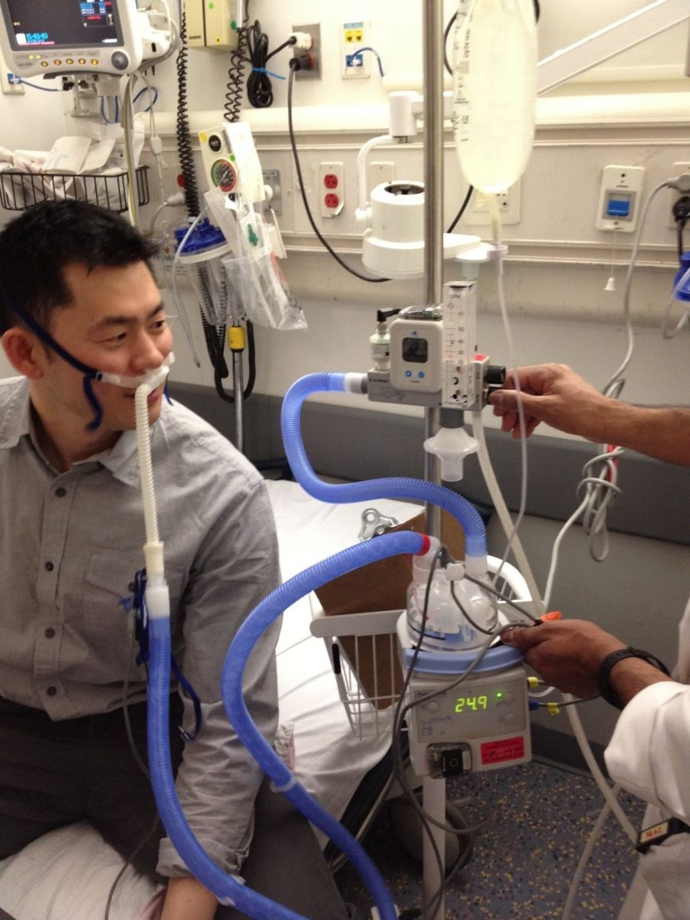
HIGH FLOW NASAL CANNULA

Slide 61
higher flow of oxygen,
warm and humidified oxygen
causes the patient to rebreathe less exhaled air (the elimination of CO2)
small amount of PEEP

Slide 62
High-flow nasal cannulas will aerosolize the COVID-19 virus

